Slide 1
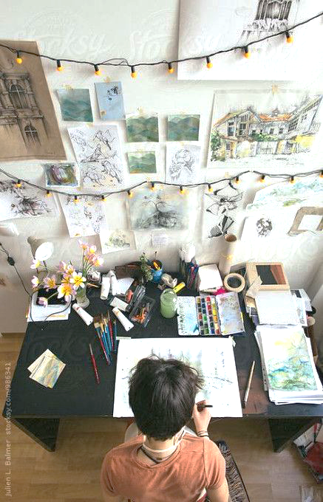
A Level Assessment Objectives
A guide to building your sketchbook

Slide 2
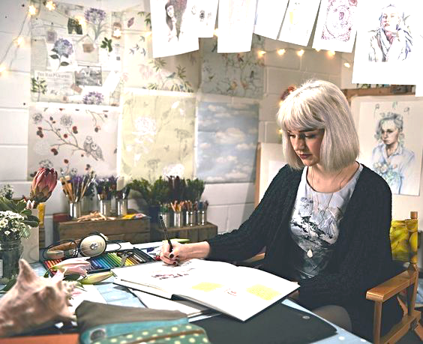
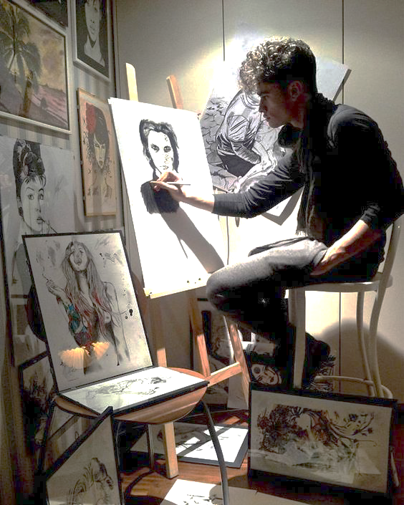

Slide 3
A01: Develop ideas through investigations, demonstrating critical understanding of sources
Design and develop ideas around your theme.
Show that you understand the meaning/intentions of other’s artwork and how this enhances your ideas.
Collect images and then take photos to use in your work.
Checklist:
2 x written mind-maps A3
Visual mind-map A3
Observational Drawings
Primary Research: photos
Secondary Research: artist examples
Statement of intent

Slide 4
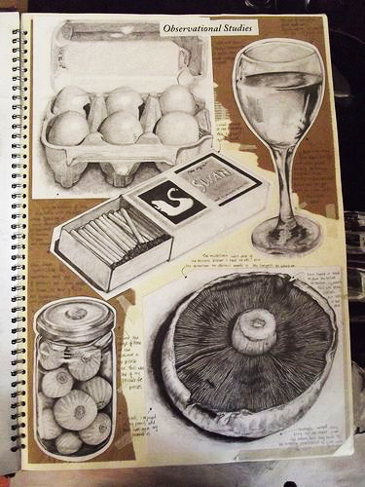
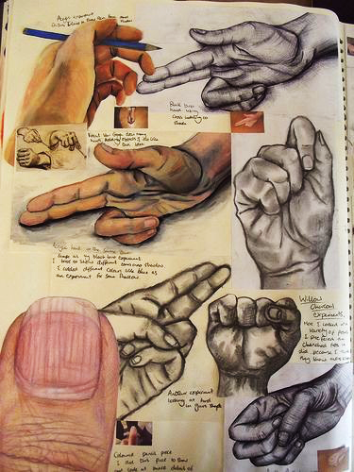
AO1: Observational Drawings
Photography Tips:
Collect a range of objects and images to draw from, that relate to your theme
Use a variety of materials like pencil, colour pencil, watercolour paint and biro
You don’t have to draw the entire object, but your drawing does have to be a high standard

Slide 5
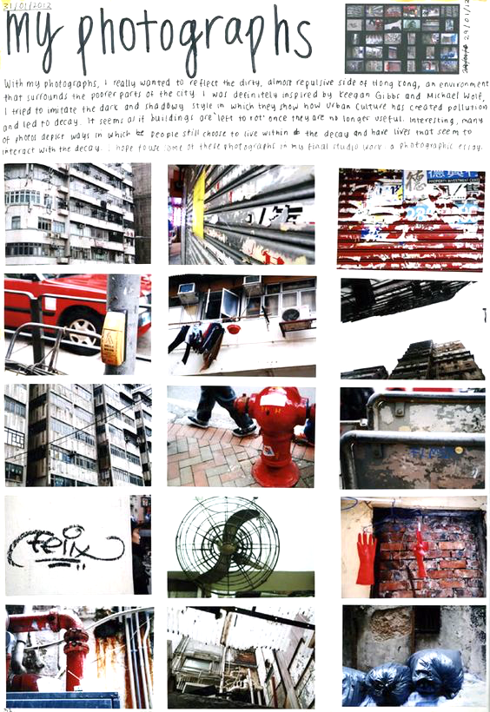
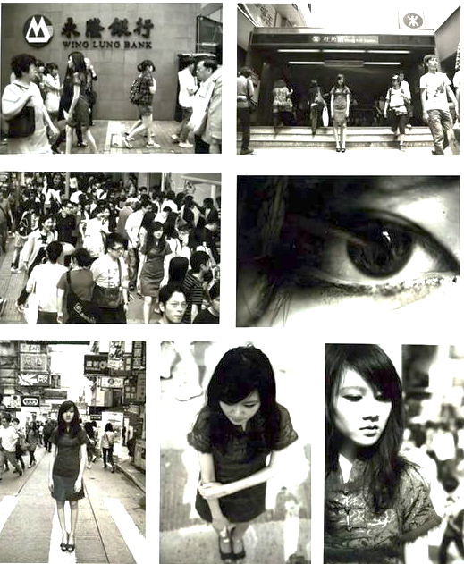
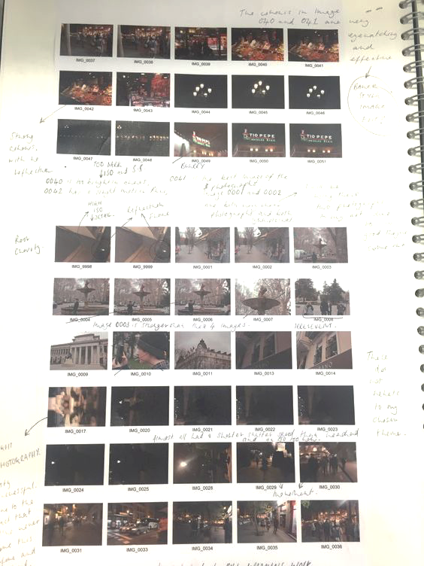
AO1: Primary Research Photos
Take photos that relate to your theme
You need at least 30
They need to show a variety of ideas
Photography Tips:
Use good lighting conditions, take photos outside or with the window behind you
Make sure images are in focus
Take lots of photos of the same thing from different angles
Annotate: WWW/EBI
Which photos do you intend to use in your project and why?

Slide 6
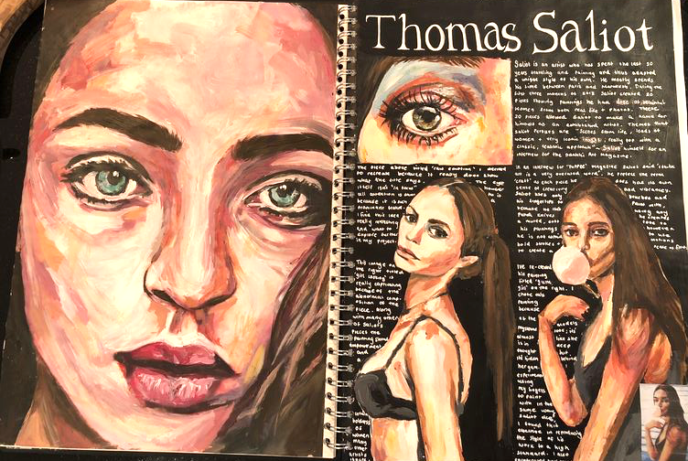
AO1: Artist Copies and Analysis
Intro to the artist and their style of work (painting, sculpture, collage…and what the main themes are)
How has the artist used techniques and materials? And how does this portray (show) meaning?
How does this artist relate to your theme? What techniques/use of materials do you intend to apply to your own work?
Don’t forget the test strip!

Slide 7
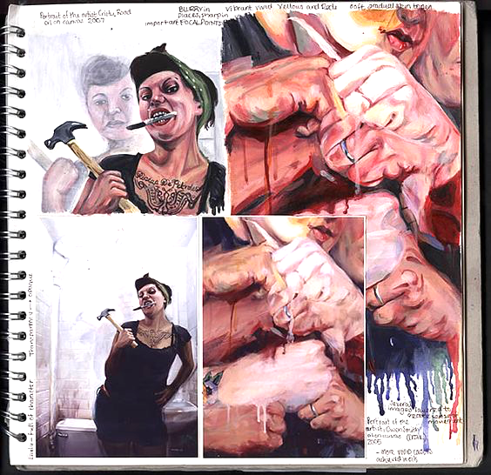
A02: Explore & experiment with appropriate resources, media, materials, techniques & processes
Use the artist’s styles and techniques in your own work
Experiment with materials that show your theme such as different colours, textures, materials and compositions.
Explore how different materials change, improve, enhance our understanding of your theme.
Checklist
Artist Copies
Experimenting with the Formal Elements
Experiments in various media
Experiments with a variety of techniques
Range of drawings in various sizes (you can include smaller thumbnail drawings)

Slide 8
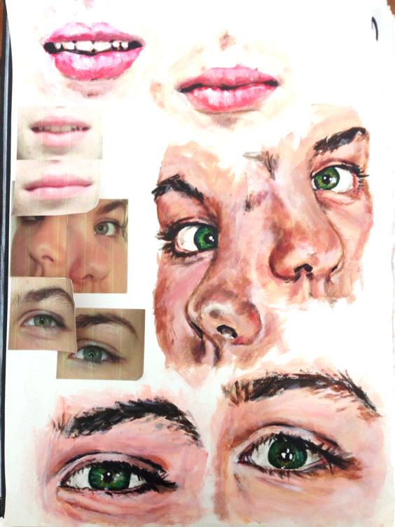
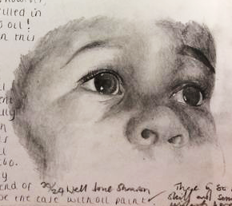
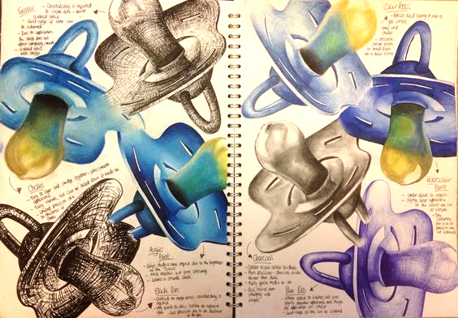
AO2: Experimenting with materials & techniques
Make sure to work from your own photos! You can use secondary sources (the internet/magazines) but you need to mostly work from your own images.
Take one of your drawings and redesign it a few times using different materials such as pencil, pen, colour pencil…
You could complete a range of smaller drawings/experiments but you could just complete 3 or 4 experiments in much greater detail.
Test out materials, explore how different colour combinations impact your designs
Remember, your experiments need to clearly relate to your theme!

Slide 9
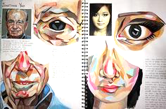
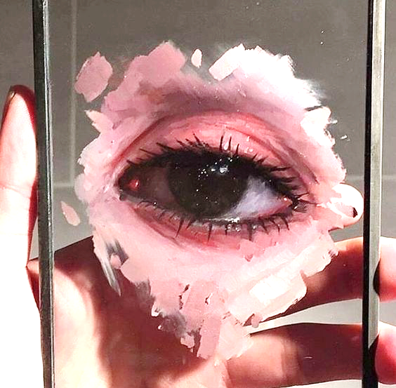
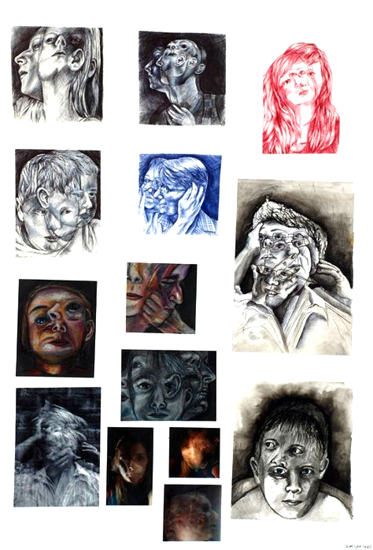
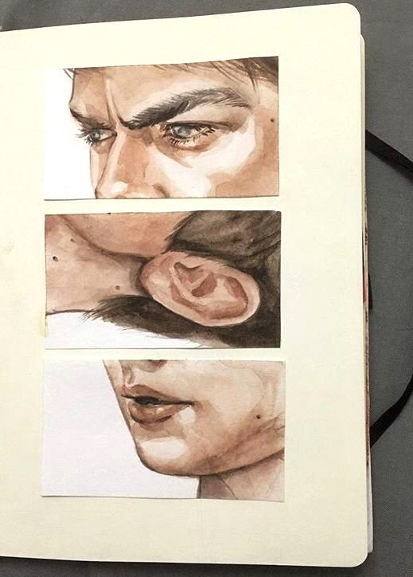
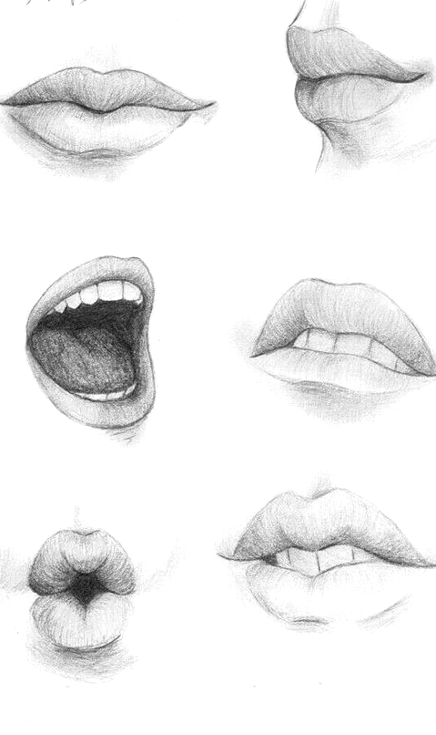
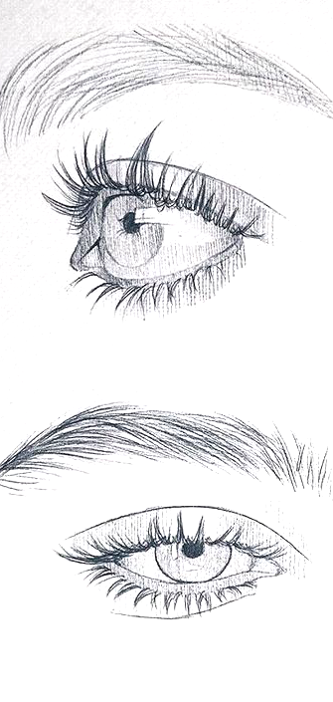
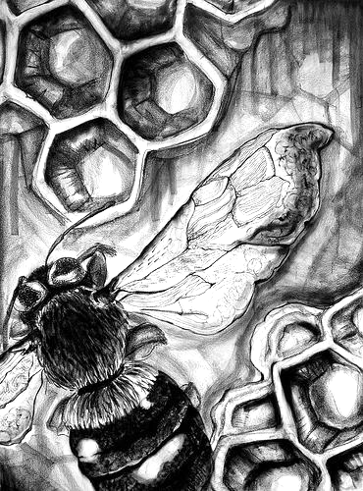
AO2: Experimenting with materials & techniques
Use the artist's techniques in your design
Experiment with different surfaces
Don’t be so obvious, zoom in on sections of your photos, this makes for visually interesting artworks
Don’t just make large artworks, experiment with smaller designs as well. They’re quicker and you can often produce a higher quality art work!

Slide 10
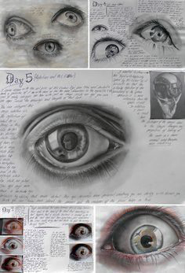
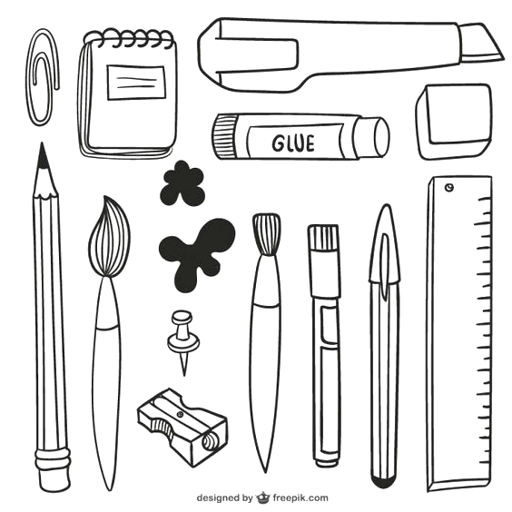
A03: Record ideas, observations and intentions, reflecting critically on work and progress
Write about the artist’s work, describing and evaluating what they did, how and why.
Explain how the artists you have looked at relate to your theme and how you intend to use their style/techniques to develop your ideas.
Discuss how well your experiments show your theme
Evaluate the work you have made in your experiments and what you intend to do next
Checklist:
Annotations evaluating what went well, and what’s next
Artist Analysis
Test strips
Quick sketches
More photos: as your theme develops you should take more specific photos and collect secondary sources that relate directly to individual pieces
Final Piece Plans

Slide 11
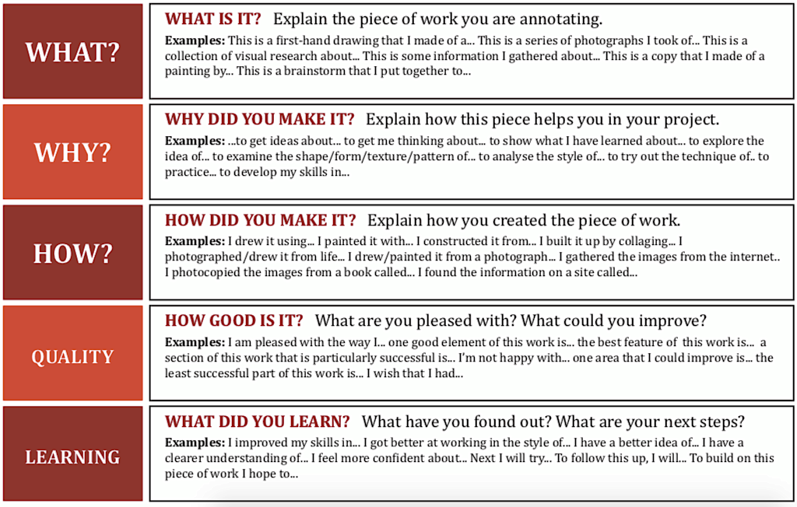
AO3: Record ideas, observations and intentions evaluating work

Slide 12
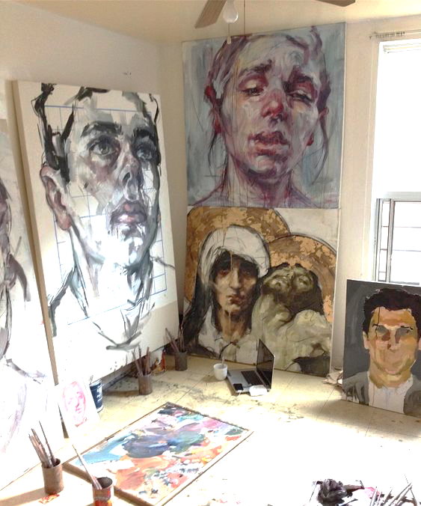
A04: Present personal and meaningful responses and make connections between visual and other elements
Create work that clearly shows your theme
Demonstrate a personal response to your theme, creating original and unique artwork
Make sure that you have considered composition and the use of materials and how they show meaning
Checklist:
All practical work including ALL experiments, annotations and research
Developed pieces
Final Piece

Slide 13
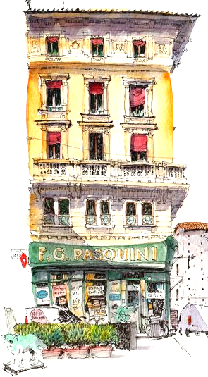
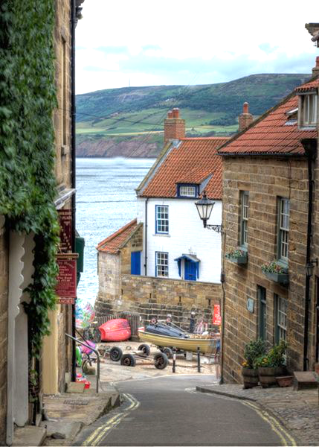
AO4: Present a personal and meaningful response
Sketch out ideas for your final piece. Make sure to include combinations of techniques used by your artists. Think very carefully about making your theme clear in your final piece
Final Piece
Take inspiration from your favourite artists
Work from your primary photos
Don’t forget the test strips!

